Slide 1

Pre-Bid Meeting
Eastern Regional Water Reclamation Facility Operations Building Renovation
Project No. 130012-59

Slide 2
Summary of Work
The Eastern Regional Water Reclamation Facility Operations Building Renovation Project is a comprehensive two-story renovation to modernize infrastructure and enhance operational efficiency to office spaces, small lab, breakroom, and a combined locker rooms/restrooms.
The scope of work includes general trades, structural, mechanical, plumbing, electric, technology and landscaping improvements.
Located in the City of Kettering, Ohio.
Eastern Regional Water Reclamation Facility Operations Building Renovation

Slide 3
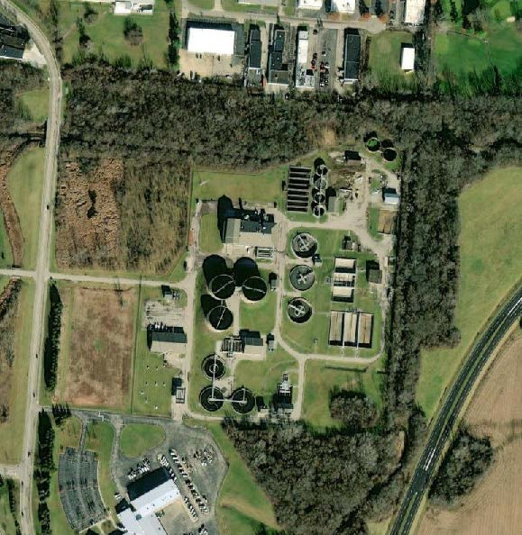
1802 Spaulding Rd., Kettering, Ohio 45432
Eastern Regional Water Reclamation Facility Operations Building Renovation

Slide 4
General Information
Prevailing Wage Project
Engineer’s Estimate: $2,372,058.00
Plans and Specifications are available for viewing and downloading by accessing the Montgomery County website at www.mcohio.org/onlinebids, at no cost.
Eastern Regional Water Reclamation Facility Operations Building Renovation

Slide 5
Bidding
The bid is a Single Prime Contract.
All contractors interested in placing bids for this project are required to be present at this meeting. Please make sure you are signed in so that your bid remains valid during the review process.
All bids must include the Bid Submittal Documents as defined in the Instructions to Bidders 00100 for bid to be considered valid.
The deadline for substitution requests is August 13 at 1:30 pm.
The deadline for pre-bid questions is August 20 at 1:30 pm.
Electronic Bids will be accepted through Montgomery County’s OpenGov Procurement portal until 1:30 PM on August 27, 2025.
If bids are 120% of estimate or greater, the bid cannot be awarded.
Eastern Regional Water Reclamation Facility Operations Building Renovation

Slide 6
Miscellaneous
All Ohio and City of Kettering building codes apply. Plan approval by the City of Kettering is currently in review.
Temporary utilities - Contractor can use owner utilities during construction.
Contractor must provide separate portable toilets for contractor use.
Clear access through egress corridors, stairwells, and the elevator must be maintained throughout construction.
Hazardous Materials – No hazardous materials are anticipated. Refer to report in document.
Security gates at ERWRF opens at 6a and closes at 5p (Monday-Saturday).
Eastern Regional Water Reclamation Facility Operations Building Renovation

Slide 7
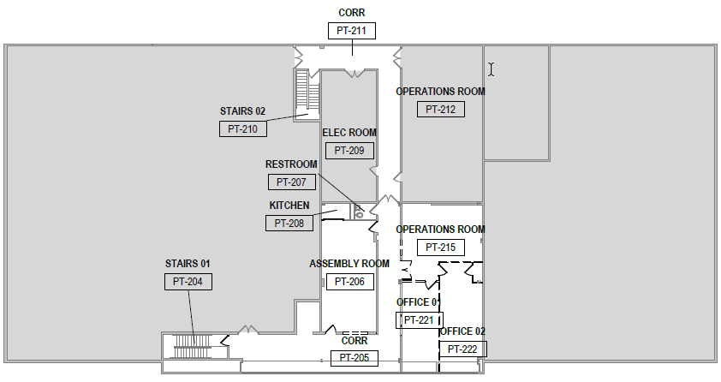
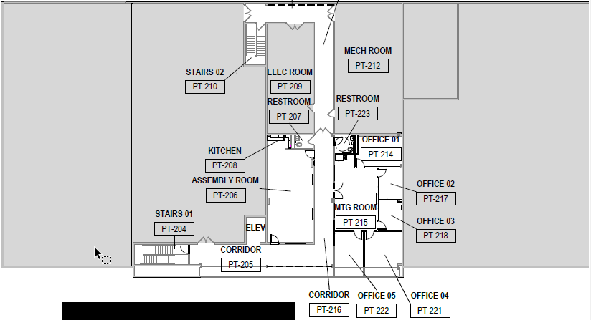
Phase One (2nd Floor) must be completed and approved for occupancy prior to the start of phase two demolition
Current Layout
Post Renovation
Eastern Regional Water Reclamation Facility Operations Building Renovation

Slide 8
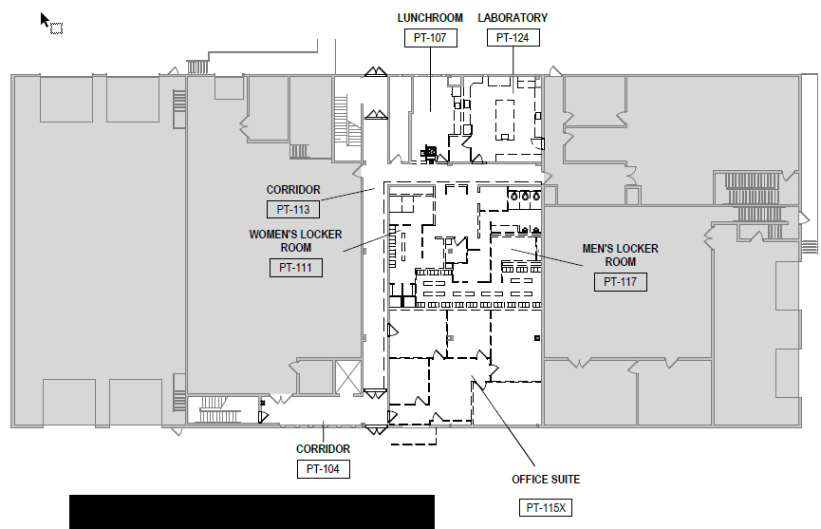
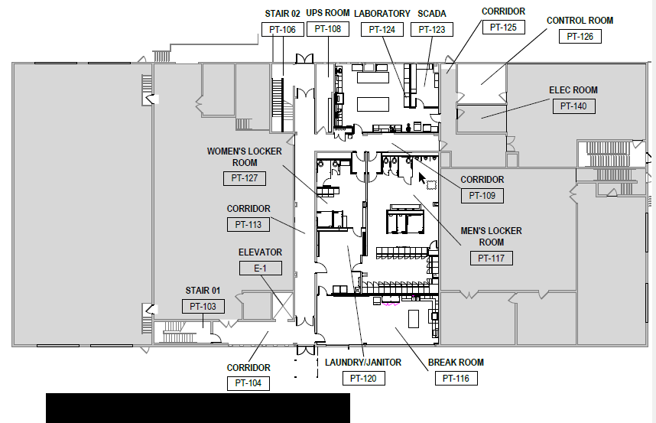
Phase Two combined locker rooms/restrooms, labs, and offices on the first floor will be renovated.
Current Layout
Post Renovation
Eastern Regional Water Reclamation Facility Operations Building Renovation

Slide 9
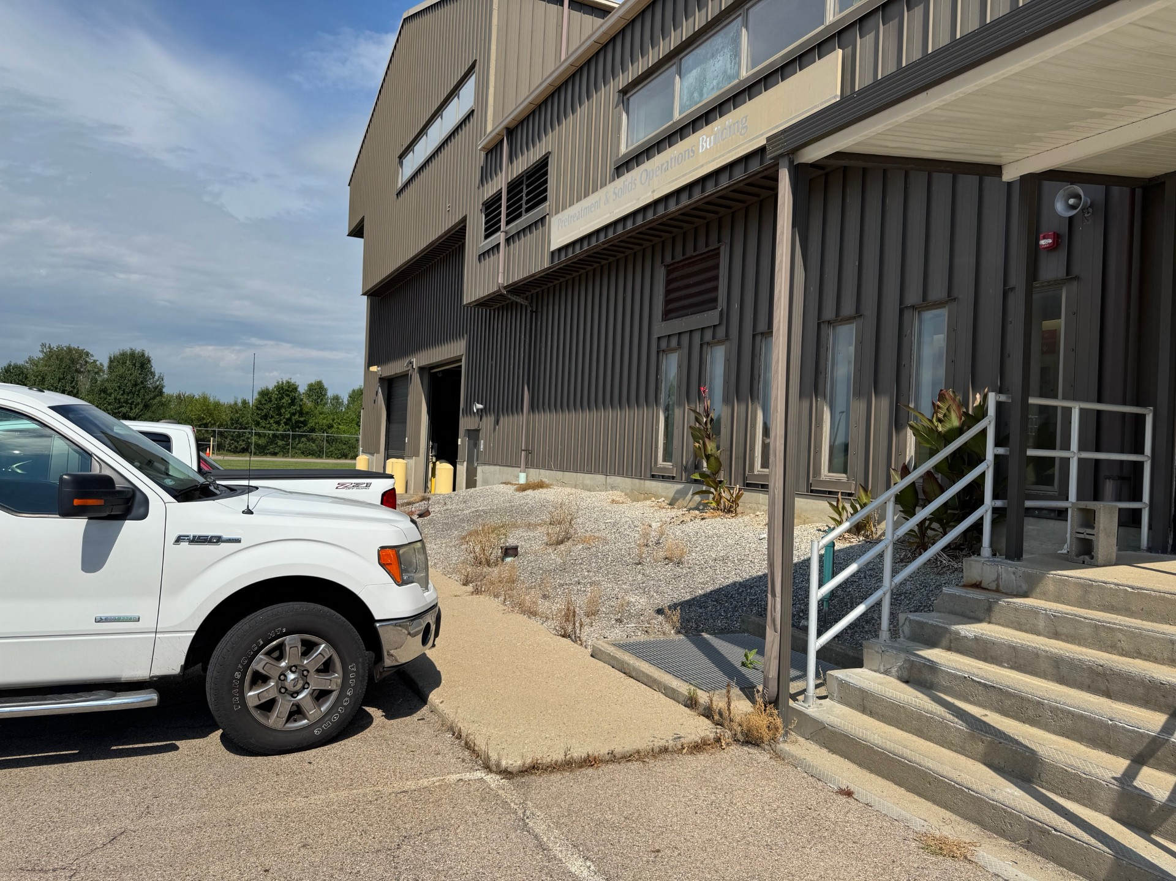
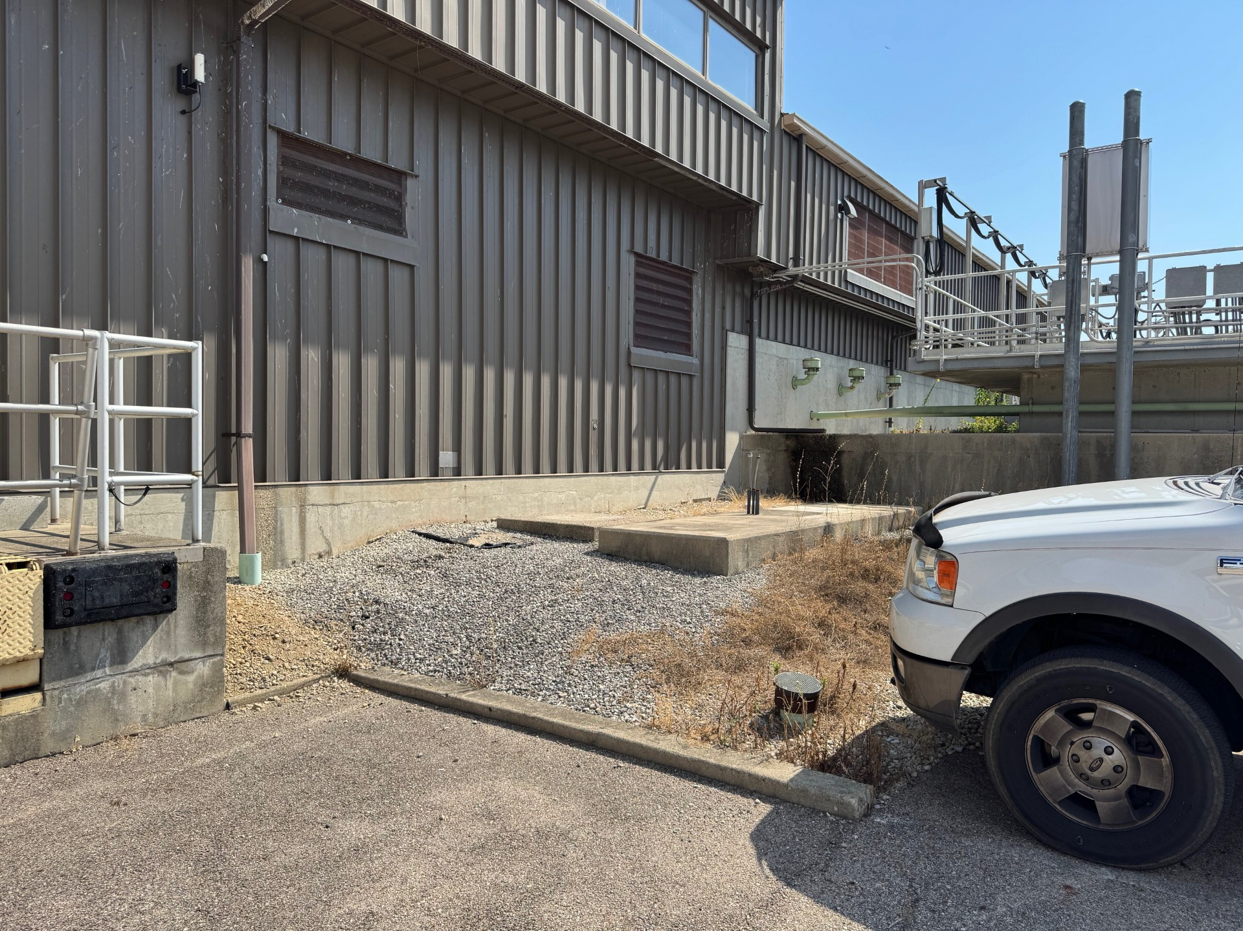
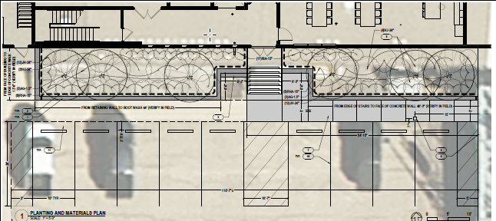
Landscaping in the Front
Eastern Regional Water Reclamation Facility Operations Building Renovation

Slide 10
Schedule
Bids opened August 27, 2025.
Contract authorized within 30 ± days.
Phase One Completion within 180 calendar days.
Phase Two Completion within 365 calendar days.
Substantial Completion within 365 calendar days.
Contract Completion at 395 calendar days.
Eastern Regional Water Reclamation Facility Operations Building Renovation

Slide 11
After Meeting
Questions?
All questions shall be submitted in writing to Barb Asberry, Purchasing Department: asberryb@mcohio.org
MCES Prebid Walk Through
  A site tour of the Eastern Regional Water Reclamation Facility Operations Building located at 1802 Spaulding Road, Kettering, OH 45432 will commence immediately following the Prebid Meeting.
Eastern Regional Water Reclamation Facility Operations Building Renovation

Slide 12
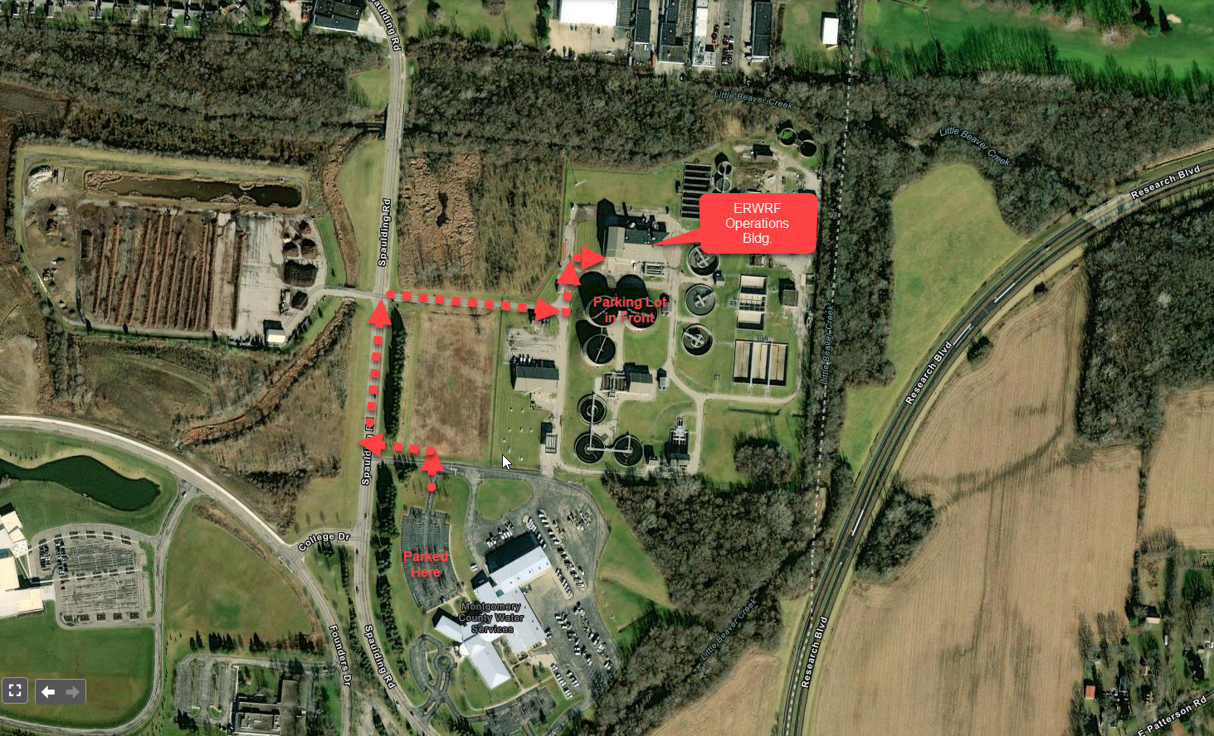
MCES Prebid Walk Through
  A site tour of the Eastern Regional Water Reclamation Facility Operations Building located at 1802 Spaulding Road, Kettering, OH 45432 will commence immediately following the Prebid Meeting.
Eastern Regional Water Reclamation Facility Operations Building Renovation

